Slide 1

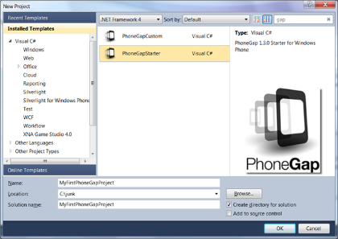


Tools for PhoneGap Developers
Eclipse + Android SDK, VS + Windows Phone SDK
Hybrid Mobile Applications
Telerik Software Academy
http://academy.telerik.com

Slide 2

Table of Contents
PhoneGap in Eclipse + Android SDK + Android Emulator + Android Development Tools (ADT)
The AppLaud Eclipse Plugin
PhoneGap in Visual Studio + Windows Phone SDK + Windows Phone Emulator
PhoneGap in iOS + Xcode + iPhone Simulator
PhoneGap Build

Slide 3
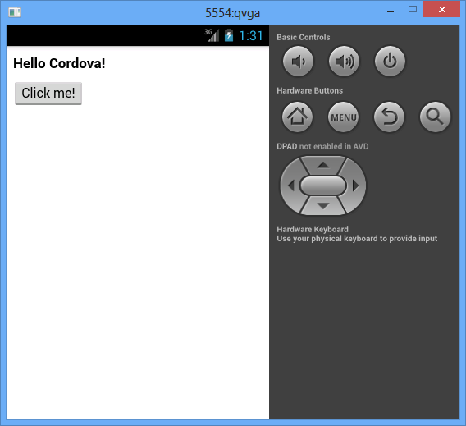
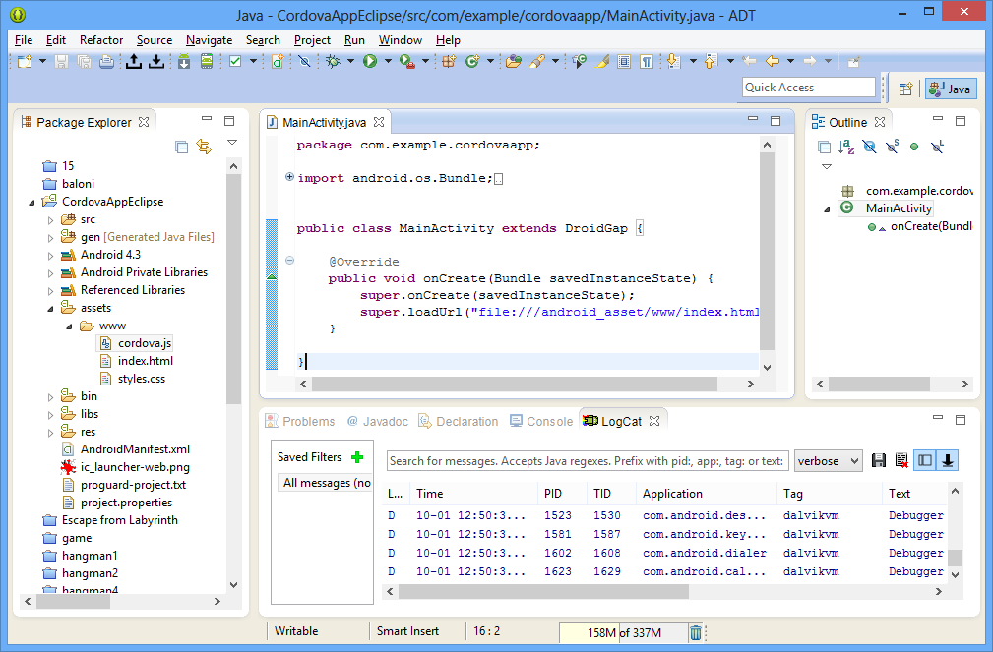
PhoneGap in Android SDK
Eclipse + Android SDK + Android Emulator + Android Development Tools (ADT) + Cordova

Slide 4
Installing Android SDK + ADT
Install Java (JRE 7) – http://java.com
Install Eclipse + Android Developer Tools (ADT) + Android SDK
http://developer.android.com/sdk/
Android SDK Manager
Download and install system images
Android Virtual Device Manager
Create new Android Virtual Device (AVD)
Install "Eclipse Web Developer Tools" plug-in

Slide 5
Setting Up Android Development Environment
To develop for Android, the coder needs Java development things
Java Runtime Environment
Runs Java apps
Java Development Kit
To develop Java apps
Android Software Development Kit to develop Android apps
http://developer.android.com/sdk/index.html
Tools for development
Eclipse, Android Studio, NetBeans

Slide 6
Setting up: Installing Java
Installing the Java Runtime Environment (JRE) allows the PC to run Java apps
Includes the Java Virtual Machine (JVM)
Donwload from https://www.java.com/en/download/
Install the Java Development Kit (JDK)
Builds Java code into apps
Download from http://www.oracle.com/.../java/downloads/index.html
Needs to be added to the PATH
Adding JAVA_HOME environment variable helps a lot

Slide 7
Installing Java
Live Demo

Slide 8
Setting up: Installing Android SDK
The Android SDK is used to develop apps for Android
Can be downloaded separately from http://developer.android.com/sdk/index.html
And then manually install Eclipse and set it up yourself (not good)
Can be downloaded with a setup Eclipse for Android development – Android developer Tools
Can be downloaded with Android Studio
Adding to PATH and a environment variable ANDROID_SDK_HOME can be helpful

Slide 9
Installing Android SDK
LiveDemo

Slide 10
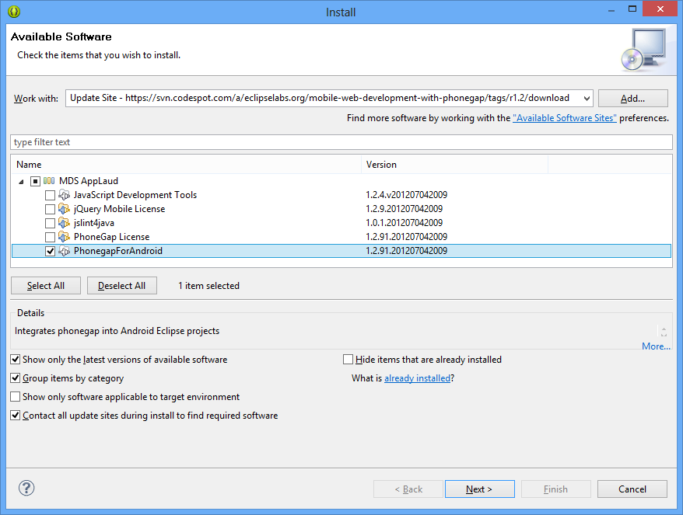
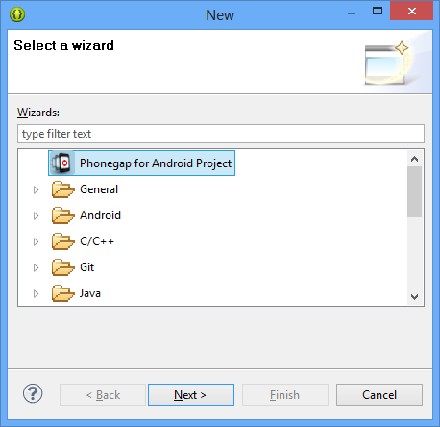
The AppLaud Eclipse Plug-in
PhoneGap for Android Made Easy

Slide 11
AppLaud Eclipse Plug-in
The AppLaud Eclipse Plug-in simplifies the PhoneGap development in Eclipse
Install though Eclipse → Help → Install New Software → https://svn.codespot.com/a/eclipselabs.org/mobile-web-development-with-phonegap/tags/r1.2/download
Once installed, the AppLaud plugin adds New → PhoneGap for Android Project

Slide 12
The AppLaud Eclipse Plug-in
Live Demo

Slide 13
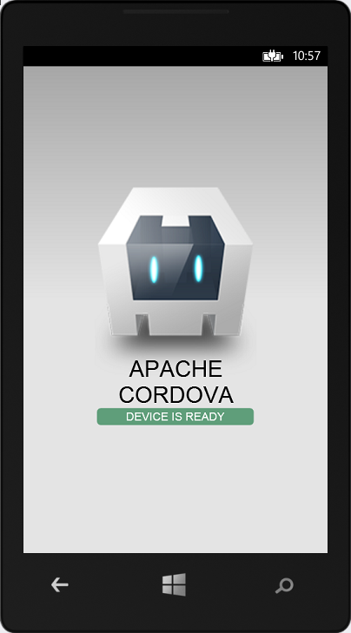
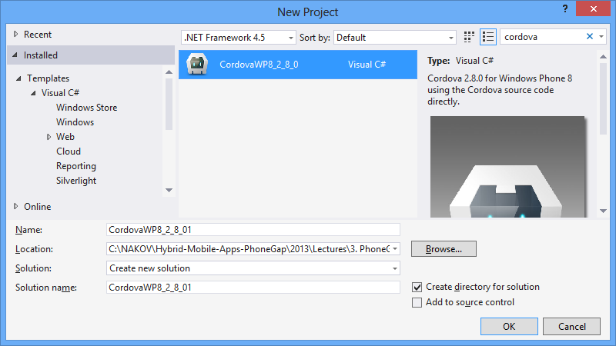
PhoneGap in Visual Studio
Visual Studio + Windows Phone SDK + Windows Phone Emulator + Cordova

Slide 14
Installing Windows Phone SDK
Install Windows Phone SDK
http://dev.windowsphone.com/downloadsdk
Windows Phone SDK 8.0 is comes built-in Visual Studio 2013
Install the PhoneGap template for Visual Studio for WP8
Download https://github.com/phonegap/ phonegap/archive/2.8.1.zip
Copy lib\windows-phone-8\CordovaWP8_2_8_0.zip to C:\Users\<user>\Documents\Visual Studio 2013\Templates\ProjectTemplates

Slide 15
PhoneGap in Visual Studio
Live Demo

Slide 16
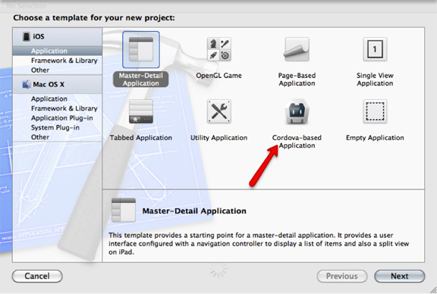
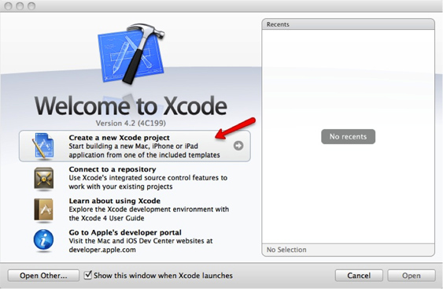
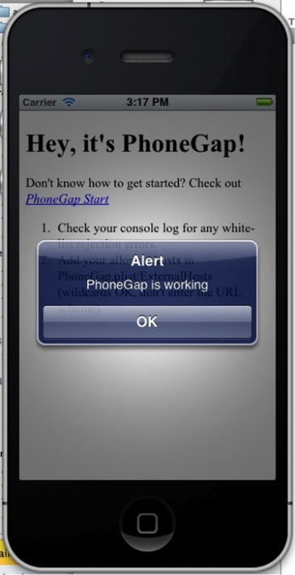
PhoneGap in iOS
iOS + Xcode + iPhone Simulator + Cordova

Slide 17
Run PhoneGap in iOS
Install Xcode
Install Cordova
Create new Cordova app
Use the script lib/ios/bin/crate
Open the generated Xcode project
E.g. HelloCordova.xcodeproj
Run the Xcode project in the iOS Simulator
* Full guidelines available at: http://docs.phonegap.com/en/3.0.0/guide_platforms_ios_index.md.html

Slide 18
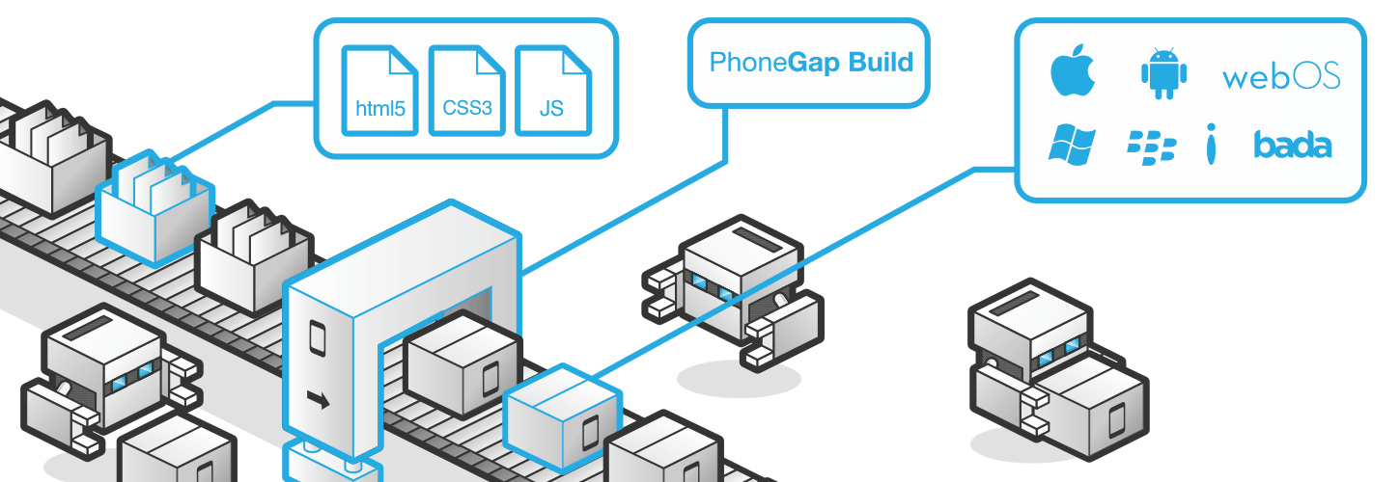
PhoneGap Build
Cloud-based Build Service for Multiple Platforms

Slide 19
PhoneGap Build
PhoneGap Build is a cloud service that builds your Cordova apps for different platforms
iOS, Android, Windows Phone, Win8, Blackberry, Symbian, etc.
Register at https://build.phonegap.com
Upload your www folder in a ZIP archive
Press the [Rebuild all] button
Scan the QR code to install the app on your Android phone / download the binary file

Slide 20
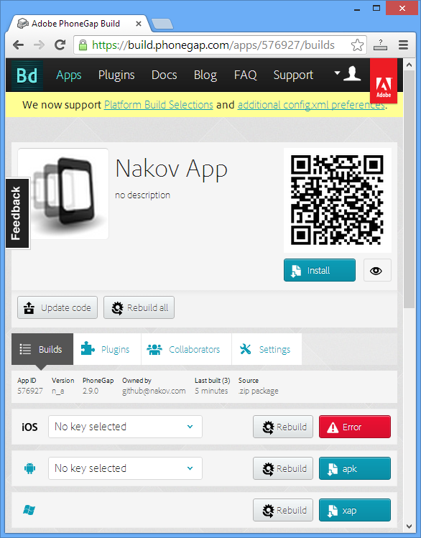

PhoneGap Build
Live Demo

Slide 21
Tools for PhoneGap Developers
http://academy.telerik.com

Slide 22
Exercises
Configure and install the PhoneGap for Android development environment
Install and configure Eclipse + Android SDK
Configure the Android Virtual Device Manager
Install "Eclipse Web Developer Tools" and "AppLaud"
Create a sample PhoneGap application and run it in the Android Emulator
Configure and install PhoneGap for WP development environment: Visual Studio + Windows Phone SDK + PhoneGap templates. Create and run a sample app.
Build a sample app using PhoneGap Build. Test it on your phone.

Slide 23




Free Trainings @ Telerik Academy
C# Programming @ Telerik Academy
csharpfundamentals.telerik.com
Telerik Software Academy
academy.telerik.com
Telerik Academy @ Facebook
facebook.com/TelerikAcademy
Telerik Software Academy Forums
forums.academy.telerik.com

